Slide 1

Language Basics (3)
Conditional branching (1)
Teacher Gao Algorithm Competition Training Camp

Slide 2
Example - Buying Ice Cream
Expressions are enclosed in parentheses
else and the following statements can be omitted
An if can only pair with one else, not multiple
else cannot appear alone
You cannot write (expression) after else
Never add semicolon after if(expression) or else
Don’t add semicolon after the curly braces, no error, just not necessary. A semicolon alone is a statement
double money,price;
cin >> money >> price;
if(money >= price)
cout << "buy";
else
cout << "Can't afford";
double money,price;
cin >> money >> price;
if(money >= price){
cout << "buy";
cout << "Vanilla";
}else{
cout << "Can't afford";
cout << "Thank you!";
}
double money,price;
cin >> money >> price;
cout <<"buy";
if(money < price)
cout << "Can't afford";

Slide 3
Syntax
Expressions are enclosed in parentheses
else and the following statements can be omitted
An if can only pair with one else, not multiple
else cannot appear alone
You cannot write (expression) after else
Never add semicolon after if(expression) or else
Don’t add semicolon after the curly braces, no error, just not necessary. A semicolon alone is a statement
if (expression)
statement;
if (expression)
statement;
else
statement;
if (expression){
statement;
statement;
…
}else{
statement;
statement;
…
}

Slide 4
Expressions and judgments
An expression can always evaluate to a value:
If value is not 0(is non-zero), it is true
If the value is 0, it is not true (false)
if ( expression ){
//do sth.
}
//do sth .after if
// First, define three variables:
int a=3,b=5,c=2;
expression | description
7/3+4 | 6 // non-zero, true
11-(4*2)-7%3 | 1 // non-zero, true
a-3 | 0 // zero, false
a%c - b%c | 0 // zero, false
a=3 | 3 // Non-zero, true. The value of an assignment statement is equal to the assigned value
a=0 | 0 // Zero, false. The value of an assignment statement is equal to the assigned value
if ( expression ){
//do sth.
}else{
//do sth. else
}

Slide 5
Relational operators
// First, define three variables:
int a=3,b=5,c=2;
6 types of of relational expression operators: > , < , >= , <= , == , !=
Connect two expressions to form a relational expression, which is used to compare the two expressions.
Note: differences between == and =, != and ≠, >= and ≥, <= and ≤ difference
Attention: = means assignment, == means judging whether they are equal, which is easy to confuse.
the values of the expressions on both sides of the relational expression operator are evaluated separately, and then compared.
There are only two calculation results: true (1), or false (0)
relational expression operators have lower precedences than arithmetic operators, so if there are arithmetic oeprations, they are done before relational operations.
If there are multiple relational expression operators, the order is: from left to right, >, <, >= and <= before == and !=; where there are parentheses, evaluate what’s inside first
Relational expressions | Description
7/3+4>2*3 | 0 // evaluate both sides separately, then compare
11-(4*2)+7%3<pow(2,3)-2 | 1 // evaluate both sides of < separately, then compare
a>15 | 0
a-2!=b-3 | 1 // evaluate both sides of != separately, then determine whether they are equal
a+b < b+c | 0 // evaluate both sides of < separately, then compare the sizes
'a'<'b' | 1 // Character type is used for operations, using ASCII code
(a==3)>=(b==5) | 1 // evaluate both sides of >= separately, then compare
0<a<5 | evaluate 0<a first and get an intermediate result of either 0 or 1 Then evaluate the intermediate result <5, no matter the intermediate result is 0 or 1, the final result must be 1
(a=3)>(b=5) | 0 // evaluate both sides separately, then compare The value of an assignment statement is equal to the assigned value Note: After this expression is executed, the values of a and b have changed.

Slide 6
Logical Operators
// First, define three variables:
int a=3,b=5;
char c='w';
"And" : && , meaning "and"
"or" : || , meaning "or"
"Not" : ! , meaning "the opposite of"
&& and || are used to connect two expressions, ! only acts on one expression to form a logical expression
Evaluation process: For && and ||, evaluate the values of the expressions on both sides respectively, then perform logical operations; for !, first evaluate the value of the corresponding expression
There’re only two possible results: true (1), or false (0)
&&: If both expressions are non-zero, it evaluates to 1 , otherwise it evaluates to 0
||: If one of the two expressions is non-zero, it evaluates to 1 , otherwise it evaluates to 0
!: If the value of the corresponding expression is 0 , 1 is evaluated , and if it is non-zero, 0 is evaluated.
The precedence of logical operators: && and || are lower than arithmetic operators.
Attention: ! is higher than arithmetic operators ( +-*/% )
If there are multiple logical operators, evaluate from left to right, first !, then &&, then ||, when there are parentheses, evaluate the ones inside first
(Tips) If you can’t remember the precedence of logical operators, simply can add more parentheses
logical expression | description
a>15&&b>15 | evaluate the left side of && If the left side is 1, evaluate the right side If the left side is 0, the result must be 0, there is no need to evaluate the right side.
a-2||b-3 | evaluate the left side of || If the left side is 0, evaluate the right side If the left side is 1, the result must be 1, there is no need to evaluate the right side.
b%3==1||b%3==2
'a'<=c&&c<='z'||'A'<=c&&c<='Z' // standard way to determine whether c is a letter | evaluate the left side of || evaluate the left side of && Decide whether to evaluate the right side of && based on the results on the left side, then get the result based on the truth table Decide whether to evaluate the right side of || based on the result on the left side, then get the result based on the truth table
1<=a&&a<=5 // Standard way determine whether a is between 1 and 5 | evaluate the left side of && Decide whether to evaluate the right side of && based on the results on the left side, and then get the result based on the truth table
!(a<1||a>5) | evaluate the brackets first evaluate the left side of || Decide whether to evaluate the right side based on the result on the left side, then use the truth table to get the result According to the truth table, flip the result

Slide 7
Truth table
&& T F
T T F
F F F
|| T F
T T T
F T F
! T F
F T

Slide 8
Logical: !, &&, ||
Relational: >, <, >=, <=, ==, !=
Arithmatical:, +, -, *, /, %
Assignment: =
Negative: -

Slide 9
Boolean type
boolean
Occupies 1 byte
Value range: 0 or 1
true and false keywords, equivalent to 1 and 0
For expressions involving relational expression operators or logical operators, the result must be of bool type.
bool is the data type with the lowest precision
Automatic type conversion during evaluation: If evaluating with other data types, they will always be automatically converted to other types.
Automatic type conversion during assignment: assigning other types to the bool type, the results are only 1 or 0

Slide 10
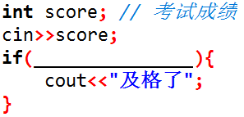
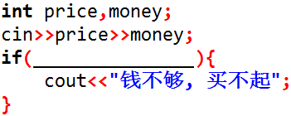
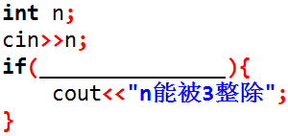
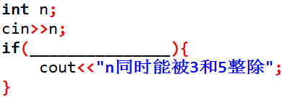
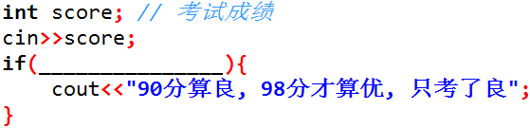
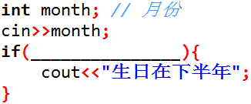
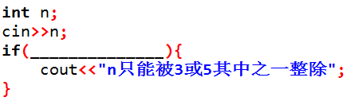
Cloze test
money < price
pass
cannot afford
n div. by 3
n%3 == 0 && n%5 == 0
n div. by 3 & 5
90: B, 98: A. You only got B.
(n%3 == 0 or n%5 == 0) and n%15
n > 6
born 2nd half
n div. only by one of 3 or 5

Slide 11
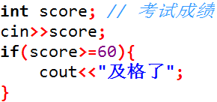
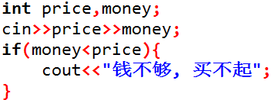
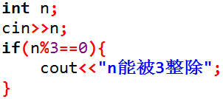
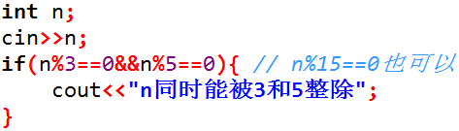
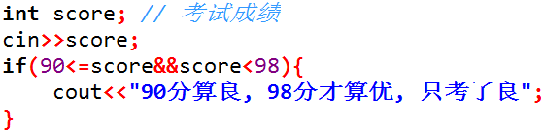
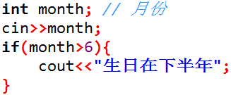
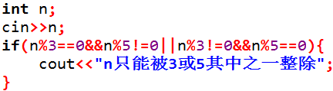
Cloze test answers
pass
cannot afford
n div. by 3
// or n%15==0
n div. by 3 & 5
90: B, 98: A. You only got B.
born 2nd half
n div. only by one of 3 or 5

Slide 12
Example - legit triangle
Natural language: The sum of any two sides is greater than the third side
int a,b,c ;
cin >>a>>b>>c;
if ( a+b >c&& b+c >a&& a+c >b )
cout << "yes" ;
else
cout << "no" ;
Logical expression A : if the sum of a and b is greater than c, and the sum of b and c is greater than a, and the sum of a and c is greater than b, it is a legit triangle, otherwise not.
a+b >c&& b+c >a&& a+c >b
Logical expression B : if the sum of a and b is less than or equal to c, or the sum of b and c is less than or equal to a, or the sum of a and c is less than or equal to b, it is not a legit triangle, otherwise is.
int a,b,c ;
cin >>a>>b>>c;
if ( a+b <=c|| b+c <=a|| a+c <=b )
cout << "no" ;
else
cout << "yes" ;
a+b <=c|| b+c <=a|| a+c <=b

Slide 13
thank you all
Note: Please turn off your microphone and camera
Teacher Gao Algorithm Competition Training Camp

